Slide 1
INFORMATION MANAGEMENT
The Relational Terminology

Slide 2
The Relational Model Objectives
Terminology of relational model.
How tables are used to represent data.
Properties of database relations.
How to identify candidate, primary, and foreign keys.
Meaning of entity integrity and referential integrity.
Purpose & advantages of views.

Slide 3
Relational Model Terminology
Database: A shared collection of logically related data, and a description of this data, designed to meet the information needs of an organisation.
DBMS A software system that enables users to define, create, maintain, and control access to the database.
Data base Application program is a computer program that interacts with the database by Issuing an appropriate request (SQL statement) to the DBMS.

Slide 4
  Relational Model Terminology
A relation: The representation of information in form of rows and columns.
It is therefore a table with rows and columns.
  Only applies to logical structure of the database, not the physical structure.
An attribute: is a named column of a relation.
Note that this is a property of an entity type in the conceptual design
Attribute domain: A set of allowable values for one or more attributes.

Slide 5
Examples
E.g 1: in the field, “registration_numbers”-The set of all allowable registration numbers is what we call a domain.
E.g 2: A domain has a logical definition: e.g.,
USA_phone_numbers are the set of 10 digit phone numbers valid in the U.S.
A domain may have a data type or a format defined for it, e.g.
  USA_phone_numbers may have the format:
  (ddd)-ddd-dddd.
  Dates have formats such as month-name, date, year or yyyy-mm-dd, or dd,mm,yyyy etc.

Slide 6
Relational Model Terminology
Tuple: Is a row of a relation.
Degree: The number of attributes in a relation.
Cardinality: The number of tuples in a relation.
Relational Database is a collection of normalized relations with distinct relation names.

Slide 7
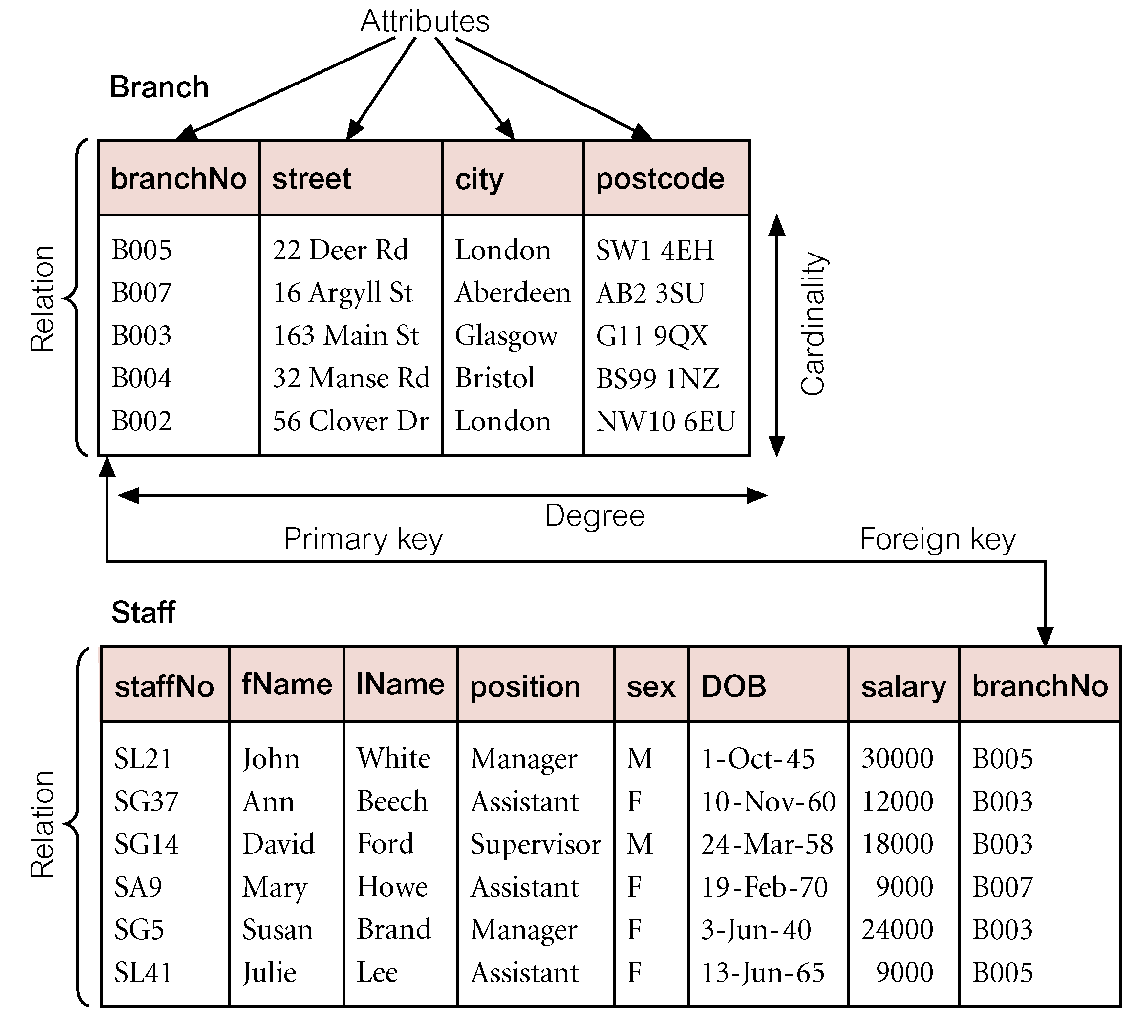
Instances of Branch & Staff (part) Relations

Slide 8
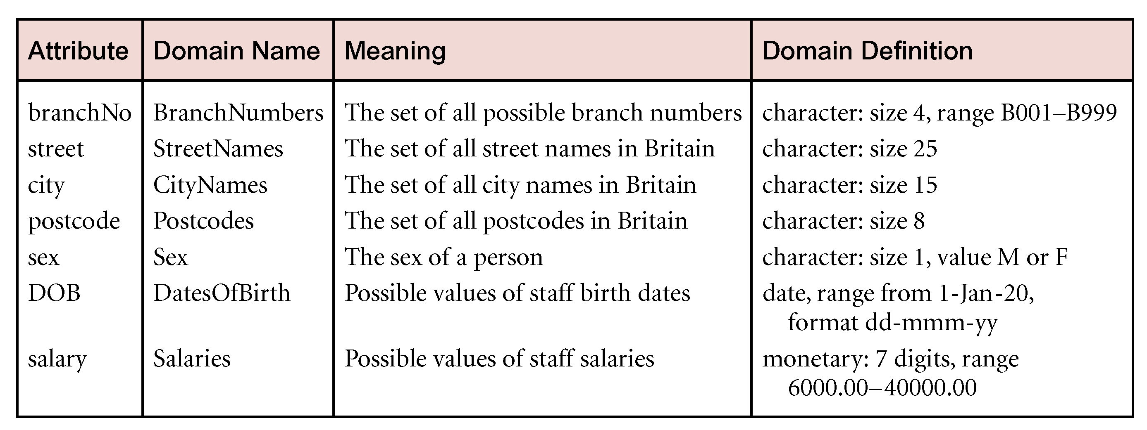
Examples of Attribute domains

Slide 9
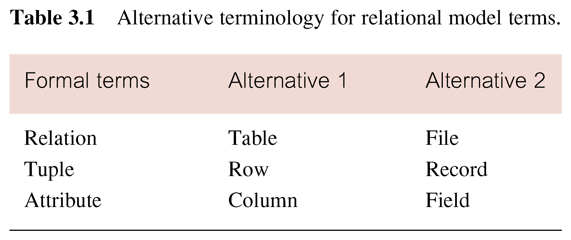
Alternative Terminology for Relational Model
Values in a column | Domain
Table Definition | Schema of a Relation
Populated Table | Extension
More → definitions

Slide 10
Database Relations
Relation schema
  Named relation defined by a set of attribute and domain name pairs.
The Schema of a Relation: R (A1, A2, .....An)
Relation schema R is defined over attributes A1, A2, …An
  e.g. CUSTOMER (Cust-id, Cust-name, Address, Phone#)
CUSTOMER is a relation defined over the attributes Cust-id, Cust-name, Address, Phone#, each of which has a domain (set of valid values),
  e.g. the domain of Cust-id is 6 digit numbers.

Slide 11
Relational database schema
  Set of relation schemas, each with a distinct name.
Is a set S of relation schemas (R) that belong to the same database.
  S is the name of the database.
  S = {R1, R2, ..., Rn}
Entity Integrity: The primary key attributes PK of each relation schema R in S cannot have null values in any tuple of r(R).

Slide 12
Properties of Relations
Relation/table name is distinct from all other relation names in relational schema.
Each cell of a relation contains exactly one atomic (single) value.
Each attribute has a distinct name.
Values of an attribute are all from the same domain.
Each tuple is distinct; there are no duplicate tuples.
Order of attributes has no significance.
Order of tuples has no theoretical significance.

Slide 13
Keys
Key field: A field used to locate ,retrieve or identify a specific record.
Candidate Key
Minimal set of attributes that uniquely identify each occurrence of an entity type/ is an attribute or set of attributes that uniquely identifies a record in a relation.
Primary Key
  A Candidate key selected to identify tuples uniquely within relation. OR
  A Candidate key selected to uniquely identify each occurrence of an entity type. Or it’s a key that uniquely identifies each record.
Composite Key
A candidate key that consists of two or more attributes.

Slide 14
Key
Non key field: Any field / column that is not a primary or candidate key.
An alternate key: It’s a Candidate key that is not selected to be the primary key.
Foreign key: A field in one table/relation that matches a primary key value in another table/ relation.
Composite primary key: A primary key composed of more than a single attribute.
Super key: An attribute, or a set of attributes, that uniquely identifies a tuple within a relation.

Slide 15
Relational Integrity
Null
  Represents value for an attribute that is currently unknown or not applicable for a tuple
  Deals with incomplete or exceptional data. (For example not all students have phone numbers so when capturing values for the field, phone_number, some records/tuples will have this field as null)
  Represents the absence of a value and is not the same as zero or spaces, which are values.

Slide 16
Relational Integrity
Entity Integrity
  In a base relation, no attribute of a primary key can be null.
Referential Integrity.
  If foreign key exists in a relation, either foreign key value must match a candidate key value of some tuple in its home relation or foreign key value must be wholly null.?
Enterprise Constraints
  Additional rules specified by users or database administrators.

Slide 17
Views
Base Relation
  Named relation corresponding to an entity in conceptual schema, whose tuples are physically stored in database.
View
  Dynamic result of one or more relational operations operating on base relations to produce another relation.

Slide 18
Views
A virtual relation that does not necessarily actually exist in the database but is produced upon request, at time of request.
Contents of a view are defined as a query on one or more base relations.
Views are dynamic, meaning that changes made to base relations that affect view attributes are immediately reflected in the view.

Slide 19
Updating Views
All updates to a base relation should be immediately reflected in all views that reference that base relation.
If a view is updated, underlying base relations should reflect the change. (There are restrictions on this)

Slide 20
Updating Views
There are restrictions on types of modifications that can be made through views:
Updates are allowed if a query involves a single base relation and contains a candidate key of base relation.
Updates are not allowed involving multiple base relations.
Updates are not allowed involving aggregation or grouping operations.

Slide 21
Updating Views
Classes of views are defined as:
  theoretically not updateable
  theoretically updateable
  partially updateable.

Slide 22

Thank You

